Slide 1
Internet of Things: Communications & Networking
Course Project - Offloading AI Inference from IoT Device to Cloud
Developed & Presented By: Bachhas Nikita (U1921630F)

Slide 2
Android Application Demonstrating Image Classification of Flowers

Slide 3
Table of contents
01
02
03
04
05
06
Introduction
Image Classification Model
Structure of the IoT System
Training of Model using Google Teachable Machine
Flask Server
Virtual Machine
Integration of Model & Android Application
Deploying Flask Server on Google Cloud Platform
Android Application
Testing of Application
Development using Android Studio Flamingo
Testing against live images and selected images of flowers

Slide 4
01
Introduction
A Brief Overview of the Course Project

Slide 5

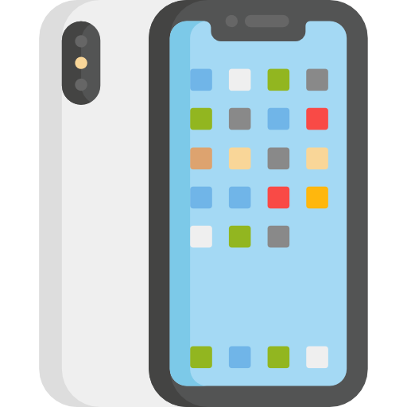

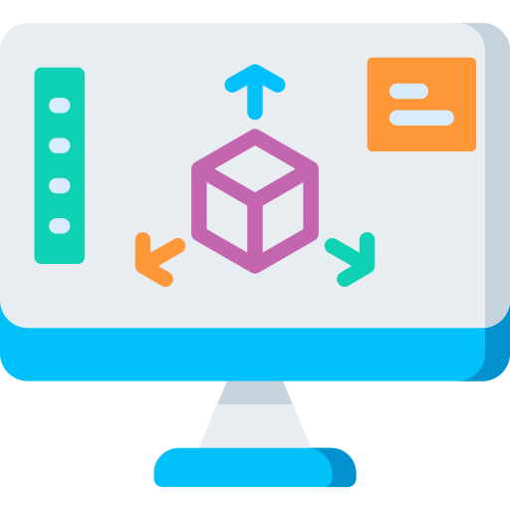

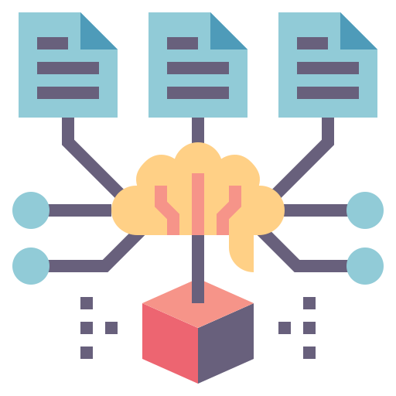
Introduction
Goal of the Project:
Collecting User Input
Uploading User Input
Obtaining Model Inference
Returning of Inference Results
Display of Inference Results

Slide 6
02
Image Classification Model
Training of the Model using Google Teachable Machine

Slide 7
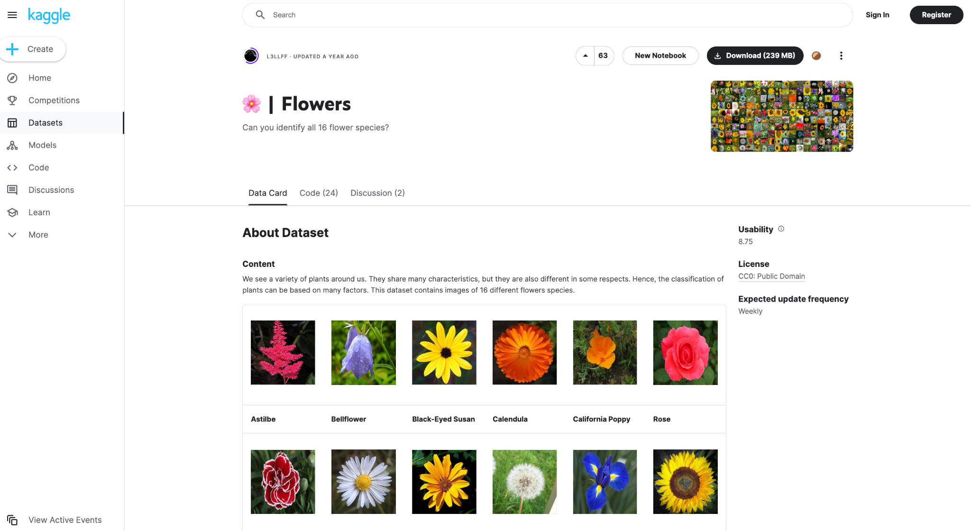
Obtaining Dataset

Slide 8
Marking Criteria
✔️ Train your own model
✔️ If train the used ML model by yourself
✔️ Training program should be in the code package
✔️ Training results (e.g., accuracy) in a readme file
✔️ The training data can be any publicly available dataset
✔️ If use downloaded pre-trained model
✔️ If use heuristic algorithm (not neural network)

Slide 9
03
Flask Server
Connecting the Android Application to the Model

Slide 10
04
Virtual Machine
Deploying Flask Server using Google Cloud Platform

Slide 11
Marking Criteria
✔️ Run inference in cloud virtual machine
✔️ If deploy server program on a cloud virtual machine, e.g.,
Azure.
✔️ If deploy server program on your own computer

Slide 12
Android Application
05
Developed using Android Studio

Slide 13
Marking Criteria
✔️ Run on emulated/physical IoT device
✔️ If the program runs natively on a desktop or laptop computer
✔️ If the program runs on an emulated or a physical IoT device
iOS emulator provided by Xcode
✔️ Android emulator
✔️ Real smartphone
Raspberry Pi + add-on sensors (camera, microphone, etc)

Slide 14
06
Testing of Application
Application Demonstration

Slide 15
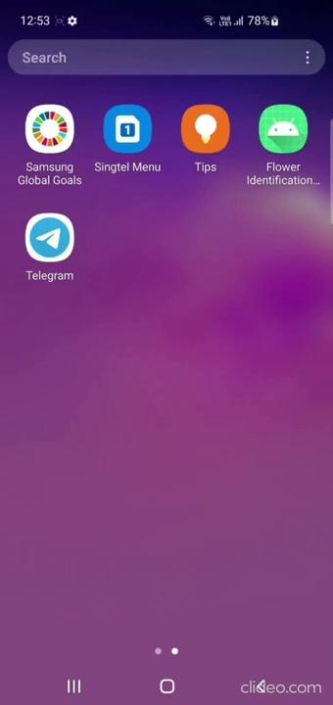
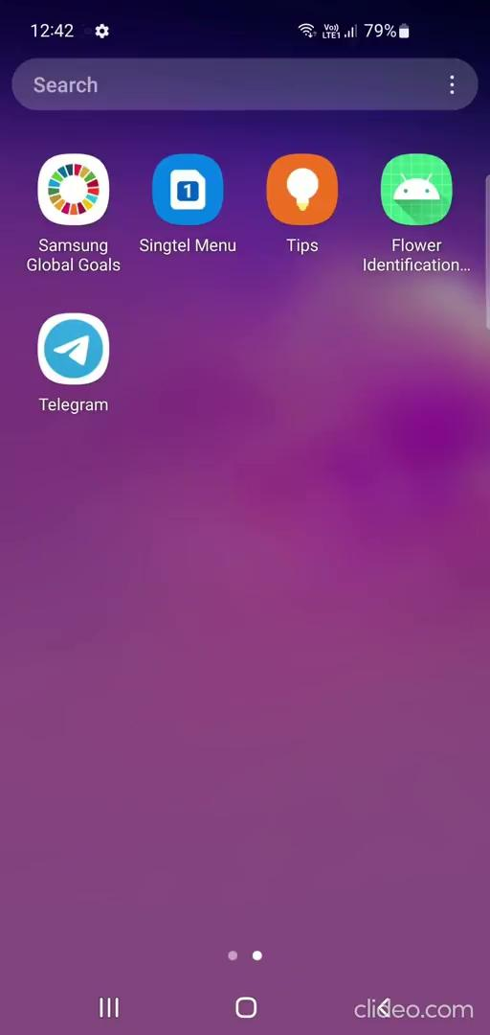
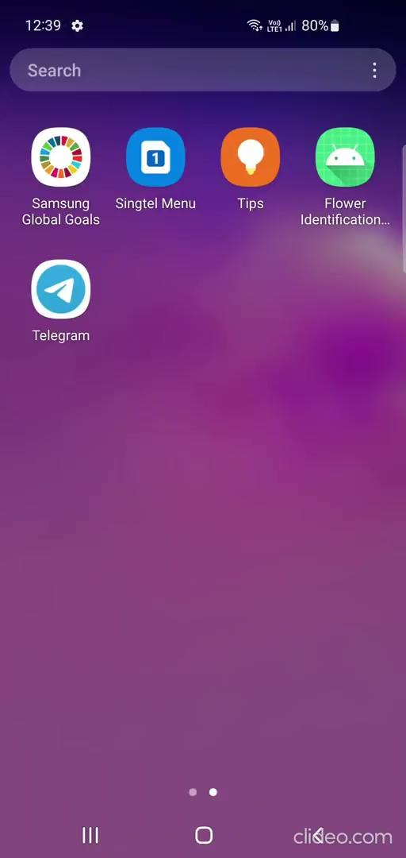
Structure of the IoT System
Image Classification Model
IoT Device
Capture Image
Select Image
Google VM + Flask Server
Flask Server

Slide 16
Conclusion
07

Slide 17
Marking Criteria
✔️ Local inference
✔️ Collect User Input
✔️ If load input from storage
✔️ If collect real-time input by touch screen, microphone, or camera
✔️ Infer locally and display result
✔️ If run model inference on the mobile app
✔️ If run heuristic algorithm (not neural network) on the mobile app
✔️ Display the inference result in real time by screen or synthetic voice
✔️ Run on emulated/physical IoT device
✔️ If the program runs natively on a desktop or laptop computer
✔️ If the program runs on an emulated or a physical IoT device
iOS emulator provided by Xcode
✔️ Android emulator
✔️ Real smartphone
Raspberry Pi + add-on sensors (camera, microphone, etc)

Slide 18
Marking Criteria
✔️ Cloud inference
✔️ Run inference in cloud virtual machine
✔️ If deploy server program on a cloud virtual machine, e.g., Azure.
✔️ If deploy server program on your own computer
✔️ Communicate btw IoT device & cloud
✔️ Send the user input from the mobile app to the cloud for inference
✔️ Send the inference result from the cloud to the mobile app

Slide 19
Marking Criteria
✔️ Advanced tasks
✔️ If train your own model
✔️ If train the used ML model by yourself
✔️ Training program should be in the code package
✔️ Training results (e.g., accuracy) in a readme file
✔️ The training data can be any publicly available
dataset
✔️ If use downloaded pre-trained model
✔️ If use heuristic algorithm (not neural network)
✔️ If Support multiple concurrent users
✔️ Demonstrate multiple IoT devices can use the cloud service simultaneously

Slide 20
THANK YOU FOR YOUR ATTENTION!

